Slide 1
Examining School Wellness Policies & Practices in Navajo Nation Schools: A Pilot Descriptive Study
Regina Eddie, PhD, RN
Assistant Professor
School of Nursing
Research supported by Southwest Health Equity Research Collaborative at Northern Arizona University (U54MD012388)

Slide 2
Background
Obesity and overweight continues to be a persistent and serious health problem among American Indian (AI) children & youth
Recent study found AI/AN children, ages 2-19 years, experience higher prevalence of obesity compared to their U.S. counterparts (~30% and 17% respectively)^{1,2}
To date, few studies in AI communities have had relative impact on health behaviors and knowledge, psychosocial, and no significant change on BMI and weight status³
Broad approaches to obesity prevention that consider policy and environmental contexts have potential for greater impact vs. approaches that target individual behavior changes^{4,5}

Slide 3
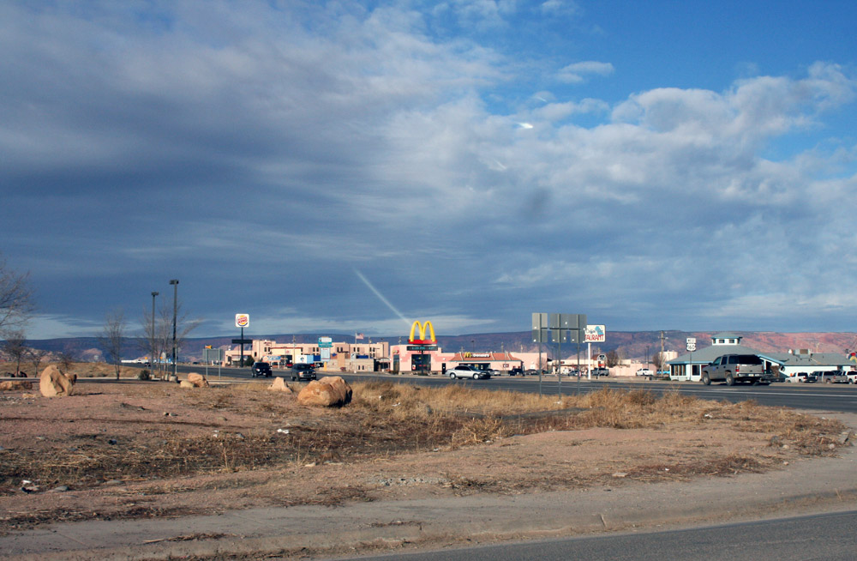
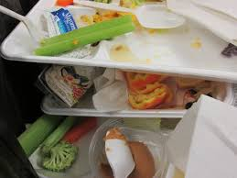
Background
Obesity is a complex and multi-faceted health problem⁶
School: Nutrition & PA influences, teachers and other support
Student Intrapersonal: Low F & V intake, high SSB intake, low physical activity, psychological issues
Interpersonal: Family & home, Peers
Community: Limited access to healthy foods and PA opportunities
Public Policy: Federal, state, local, tribal policies
(Modified Townsend & Foster, 2013)

Slide 4
Background
Schools are a prime environment for obesity prevention – children spend extended time in school, consume up to 50% daily food intake, PA opportunities⁸
Schools are mandated by federal policies (Child Nutrition and WIC Reauthorization Act of 2004; Healthy Hunger Free Kids Act of 2010) to adopt and implement a Local Wellness Policy (LWP)^{9,10}
Studies suggest LWPs enhanced healthy food options in schools, reduced access to low nutrient foods; other schools had underdeveloped, vague written policies; despite strong written LWPs in place, school encountered challenges implementation¹¹⁻¹⁴
While such extensive wellness policy research has been conducted, to date, Tribal specific data are lacking

Slide 5
Project Description
Navajo Nation School Wellness Policies & Practices Project
Purpose: To examine the quality of school wellness policies and practices that support healthy behaviors among children and youth in Navajo Nation schools
Study Aims:
Determine the prevalence and quality of school wellness policies (LWPs) related to nutrition and physical activity using an established metric, the Wellness School Assessment tool (WellSAT 3.0)
Describe school-level practices associated with student nutrition and physical activity using an existing quantitative survey instrument
Identify determinants and mechanisms that facilitate or hinder implementation of wellness practices and policies using qualitative methods

Slide 6
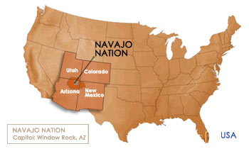
Methods
Setting: Navajo Nation is largest AI reservation, predominantly rural located in Southwest region of the U.S.; Largest AI tribe with more than 400,000 tribal members¹⁷
Study Design: Mixed methods study approach with QUAL and QUAN methodologies
Sampling: During SY 2020 – 2021, a convenience sample of 5 elementary/middle schools were recruited for study (N= 4 tribally controlled grant schools and 1 off-reservation school)
Source: https://navajobusiness.com/fastFacts/LocationMap.htm

Slide 7
Methods
Measures/Instruments
WellSAT 3.0 is a 67- policy item standardized online assessment tool used to rate the strength and comprehensiveness of LWPs in 6 sections: Nutrition Education, School Meal Standards, Other Competitive Food Standards, PE & PA, Wellness Promotion & Marketing, Implementation & Evaluation¹⁵
Each policy item subjectively scored a 0, 1 or 2; 0 indicates no mention of policy item; 1 represents item is mentioned in weak/vague language; 2 indicates strong, clear policy item
A comprehensive score is calculated
Examples of language are provided for each policy item to assist in the scoring process. Tool provides a score from 1-100. Should not interpreted like a letter grade
Wellness School Practices Survey is a 61-item reliable and valid survey with question to examine physical education, physical activity, school nutrition practices and wellness policies¹⁶

Slide 8
Methods
Study
Procedures
Aim 1: Obtained copies of LWPs (n = 5); Policy scoring/coding completed by PI and graduate RA; Scores compared; discrepancies discussed until consensus reached
Aim 2: School principals (n=5) completed a 61-item Elementary/ Middle School Wellness Practices Survey
Aim 3: On-site and one zoom semi-structured interviews were audio-recorded with principals, food service managers, PE teachers & school wellness coordinators (n=20)

Slide 9
Methods
Data Analysis
Standard descriptive statistics were used across measures
WellSAT: mean scores calculated for each of the six WellSAT categories for each school; and overall mean scores performed across 5 schools by each category and overall comprehensiveness and strength score
Wellness Practices Survey: standard descriptive procedures (means, frequencies, percentages) calculated for survey data across 5 schools
Semi-structured interviews: Interview data transcribed verbatim; initial data reviewed and explored; created codes and further refined code into meaningful data and themes

Slide 10
Results
WellSAT
WellSAT Policy Category | Mean Comprehensive Score (N=5) | Mean Strength Score (N=5)
Nutrition Education | 73 | 50
School Meal Standards | 77 | 40
Nutrition Standards for All Other Foods | 81 | 47
Physical Education/Activity | 66 | 51
Wellness Promotion & Marketing | 51 | 33
Implementation, Evaluation & Communication | 53 | 43
Overall Mean Score | 67 | 44

Slide 11
Results
Wellness Practices Survey Highlights
School Nutrition
All schools participate in the USDA School Breakfast Program & NSLP; Universal free meals to students
3 out of 5 schools indicate students have recess before lunch
Of the 5 schools, food waste occurs somewhat in 3 schools and not much in 2 schools
Students or parents have not been engaged in healthy eating strategies (i.e. Student taste tests, cooking demos/classes, newsletters)
All schools (5) do not have vending machines available to elementary students
3 out of 5 schools, teachers use candy as a reward for good academic performance and good behavior
Of the 5 schools, policies on sugar-sweetened items vary - 1 school had no policy, 2 sweetened items discouraged and 2 prohibited
All schools do not have a process to train on rules for fundraising and food/beverage sales at the schools

Slide 12
Results
Physical Education & Physical Activity
2 out of 5 schools have a certified PE teacher/specialist
Average total number of minutes per day of recess for 3rd graders = 28 minutes
No recess supervisors were trained specifically in strategies for encouraging students to be more physically active
Most schools (4-5) allow students to stay inside during recess for various reasons including poor behavior, library & to complete homework
Wellness Practices
Only 2 out of 5 schools indicate one or more persons is responsible for implementing school wellness policy
Frequency of school wellness team meetings vary across schools (ranging from never to 4 times a year)
3 out of 5 schools provided little to no resources (training, equipment) for fostering a healthy school environment

Slide 13
Results
Key themes from Qualitative Interviews (in progress):
Challenges in eliciting teacher, staff and parent engagement in wellness
Professional development of staff
“More training is needed of staff on wellness”; “We are very remote and we hardly have any resources to guide us”
“Teachers need training on what is healthy to give kids in the classroom”
Connection with cultural resources
“Having cultural resources such as elder are good for the students”

Slide 14
Conclusion
Overall, findings clearly indicate schools on the Navajo Nation are in need of support; specifically, to ensure LWPs address recommended/required content and are written in strong, clear language
WellSAT comprehensives scores were lower (missed policy content areas) in NS, PE, WP and Implementation & Evaluation; Strength scores were lower across all categories < 50 meaning policy written in vague, weak language
From a practice perspective, some strengths are free lunch served to all students; recess before lunch & food waste not a significant problem.
Areas needing improvement: Explore opportunities to reduce snacks, sugar-sweetened items in schools (classrooms, fundraising) & promote more physical activity are needed
Given the quality of wellness policies, can explain why schools are not implementing policies into practice

Slide 15
Implications/Future Research
Implement study on larger scale
Explore opportunities to understand school board, community and tribal government involvement in school wellness
Explore integration of culturally-tailored practices in LWPs
Explore ways to engage teachers, staff, and parents in school wellness
Courtesy of the NB3 Foundation

Slide 16
Thank you! - Questions -

Slide 17
References
Bullock, A., Sheff, K., Moore, K., & Manson, S. (2017). Obesity and overweight in American Indian and Alaska Native children. American Journal of Public Health, 107(9), 1502- 1507.
Ogden, C., Carroll, M., Lawman, H., Fryar, C., Kruszon-Moran, D., Kit, B., & Flegal, K. (2016). Trends in obesity prevalence among children and adolescents in the United States, 1988 – 1994 through 2013-2014. JAMA, 315(21), 2292–2299.Wann, T., Hayes, L., Marshment, G., Marcum, C., Meiklejohn, M., & Branscum, P. (2015). Native American childhood obesity prevention interventions: a systematic review. Vulnerable Children and Youth Studies, 10(2),118-130.
Rodney, L., Aytur, S., Davis, T., Eyler, A., Evenson, K., Chriqui, J., Cradock, A., Goins, K., Litt, J., & Brownson, R. (2013). Policy, systems, and environmental approaches for obesity prevention; A framework to inform local and state action. Journal Public Health Management Practice, 19(3), S23-S33.
Swinburn, B. (2008). Obesity prevention: the role of policies, laws and regulation. Australian New Zealand Health Policy, 5, 1-7.
Ohri-Vachaspati, P., DeLia, D., DeWeese, R., Crespo, N., & Todd, M. (2018). The relative contribution of layers of the Social Ecological Model to childhood obesity. Public Health Nutrition, 18(11), 2055-2066.
Townsend, N., & Foster, C. (2013). Developing and applying a socio-ecological model to the promotion of healthy eating in school. Public Health Nutrition, 16(6), 1101-1108.
Welker, E., Lott, M., & Story, M. (2016). The school food environment and obesity prevention: Progress over the last decade. Current Obesity Reports, 5, 145-155.
Child Nutrition and WIC Reauthorization Act of 2004, P.L. 108-265 (2004).
Public Law 111–296, the Healthy, Hunger-Free Kids Act of 2010, Dec. 13, 2010.
Meendering, J., Kranz, E., Shafrath, T., & McCormack, L. (2016). Bigger????Better: The comprehensiveness and strength of school wellness policies varies by school district size. Journal of School Health, 86(9), 653-659.
Turgeon, B. (2013). A district wellness policy: The gap between policy and practice. Journal of Education and Learning, 2(3), 26-38.
Harvey, S., Markenson, D., & Gibson, C. (2018). Assessing school wellness policies and identifying priorities for action: Results of a bi-state evaluation. Journal of School Health, 88(5), 359-369.
Lucarelli, J., Alaimo, K., Belansky, E., Mang, E., Miles, R., Kelleher, D…Liu, H. (2015). Little association between wellness policies and school-reported nutrition practices. Health Promotion Practice, 16(2), 193-201.
WellSAT: 3.0. About the WellSAT. Retrieved from https://www.wellsat.org/about_the_WellSAT.aspx
Turner, L. (2019). Elementary School Wellness Practices Project. Retrieved from: https://healthyeatingresearch.org/research/conducting-a-large-scale-surveillance-of-public-school-environments-to-advance-wellness-related-practices-with-a-focus-on-rural-schools/
Navajo Times (2021). Diné enrolled population increases. https://navajotimes.com/reznews/dine-enrolled-population-increases-to-399494/

